Slide 1
FIFA Winner Prediction
By Harish Agarwal

Slide 2
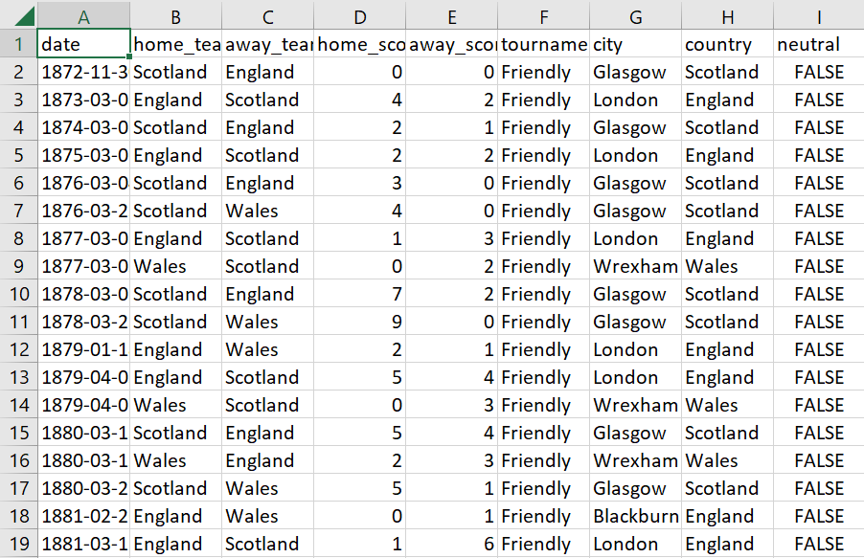
FIFA Dataset

Slide 3
Understanding Dataset

Slide 4
Importing Libraries and reading dataset
To implement dataset first we have to import some package and library
import pandas as pd
import numpy as np
import seaborn as sns
from matplotlib import pyplot as plt
import random
from IPython.display import Image
random_num=122
After that we will import our csv file
df=pd.read_csv("results.csv")
df.head()

Slide 5
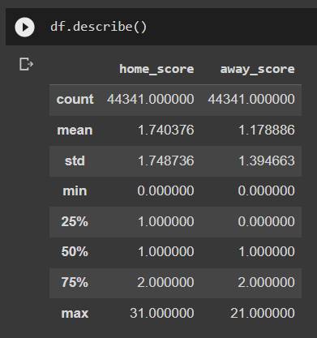
More about dataset
To find total rows and columns we use shape command
the data frame has 44341 rows and 9 columns
Describing training dataset

Slide 6
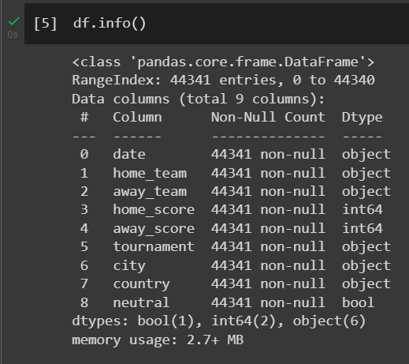
We use info() method to extract more information
Code: df.info()

Slide 7
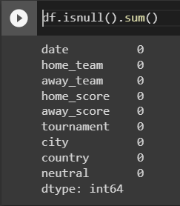
To find missing value in dataset
Code: df.isnull().sum()

Slide 8
Data Visualization

Slide 9
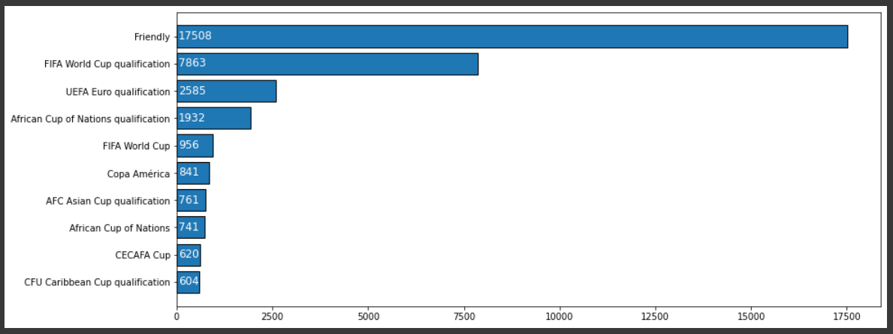
All tournaments played till now

Slide 10
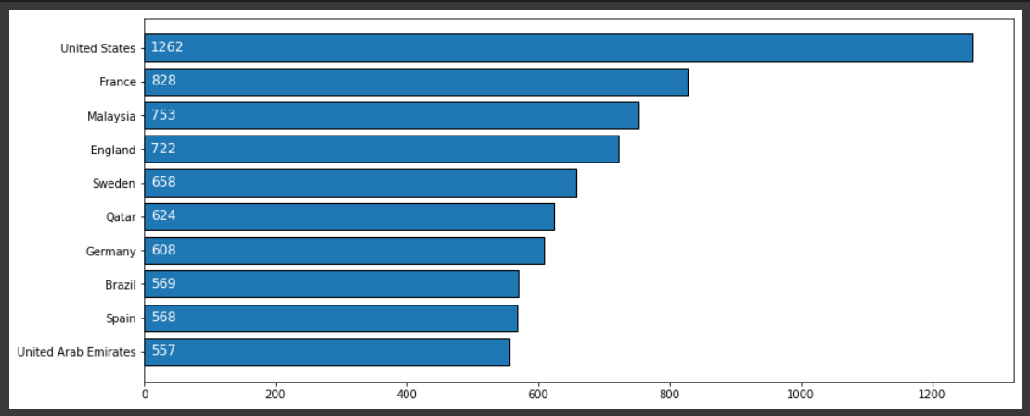
Country and their total matches

Slide 11
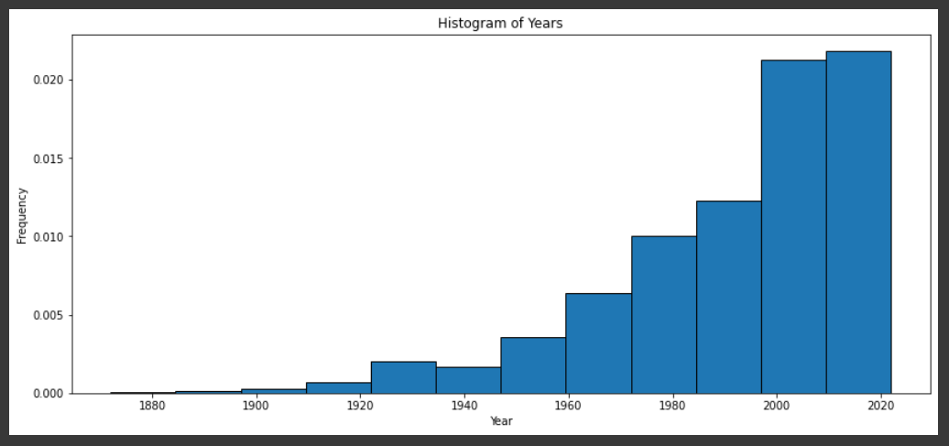
Histogram of Years

Slide 12
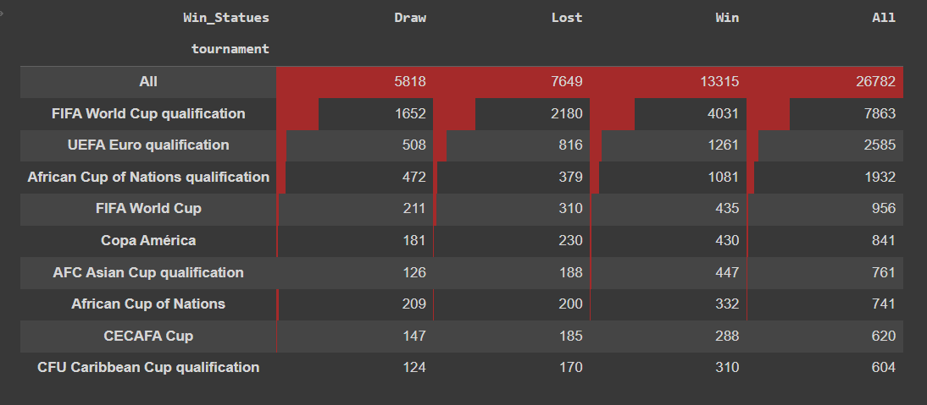
Performance of home and away team

Slide 13
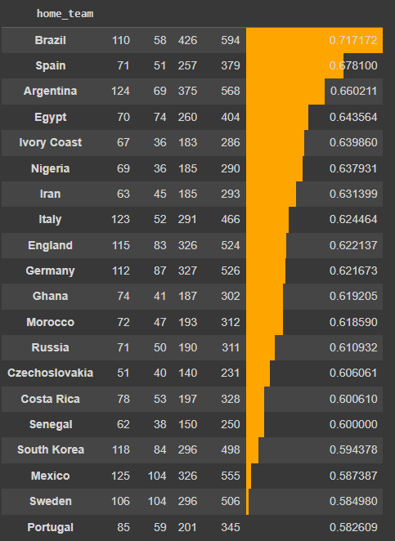
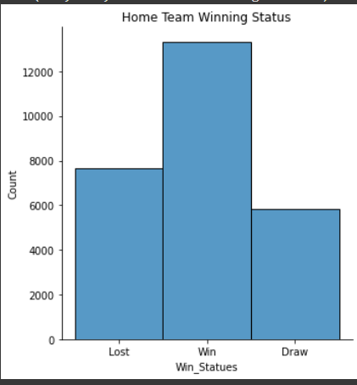
Home team winning status and probability

Slide 14
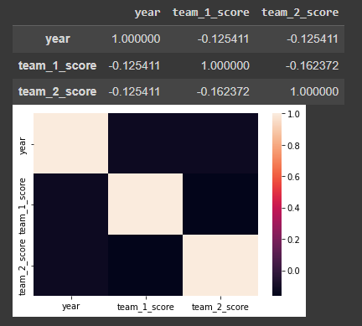
Correlation

Slide 15
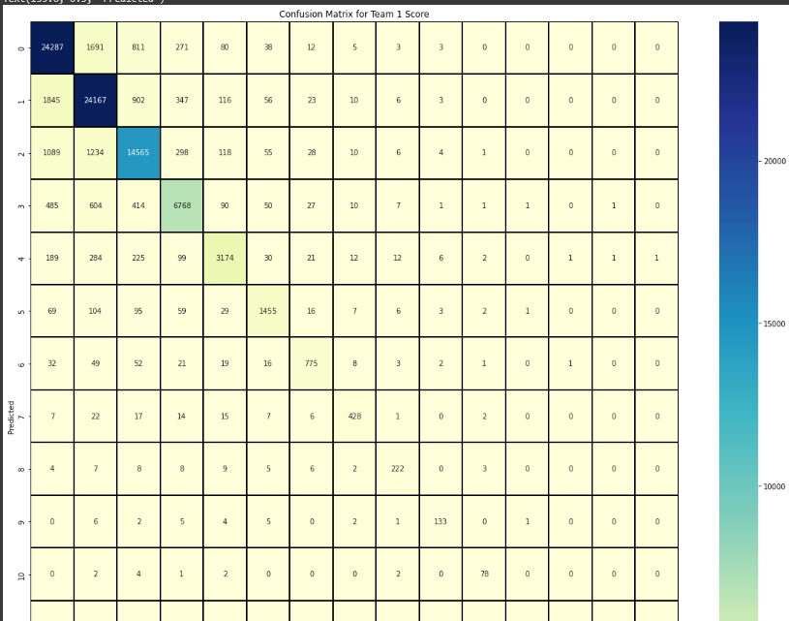
Confusion Matrix for team 1 score

Slide 16
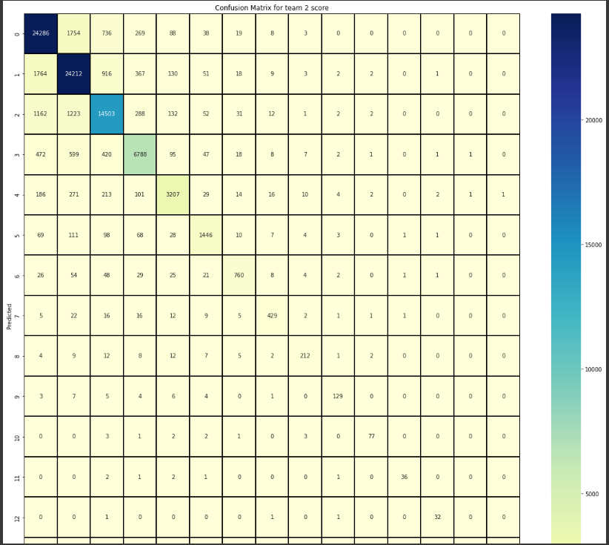
Confusion matrix for team 2 score

Slide 17
Multiple Output Regression
Code:
X=categorized_data
from sklearn.multioutput import MultiOutputRegressor
from sklearn.svm import SVC
from sklearn.tree import DecisionTreeClassifier
from sklearn.ensemble import RandomForestClassifier
from sklearn.neighbors import KNeighborsClassifier
model = MultiOutputRegressor(RandomForestClassifier())
model.fit(X,Y)

Slide 18
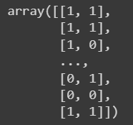
Dataset Prediction
Code:
prd=model.predict(X)
Prd

Slide 19

Final Results

